Slide 1
TruCare ProAuth 8.0
Martin’s Point Health Care
Notes:
Welcome to TruCare ProAuth Training

Slide 2
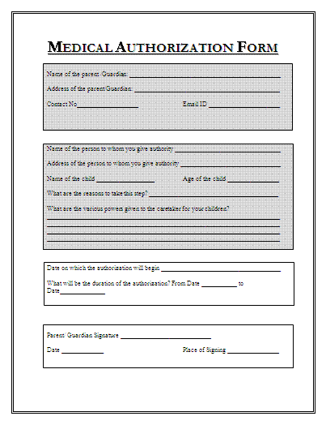
Who Uses TruCare ProAuth?
Primary Care (PCP) offices
Specialty Providers (Cardiology, Imaging, etc)
Durable Medical Equipment/Home Health
Inpatient Facilities/Hospitals
Ambulatory Centers

Slide 3
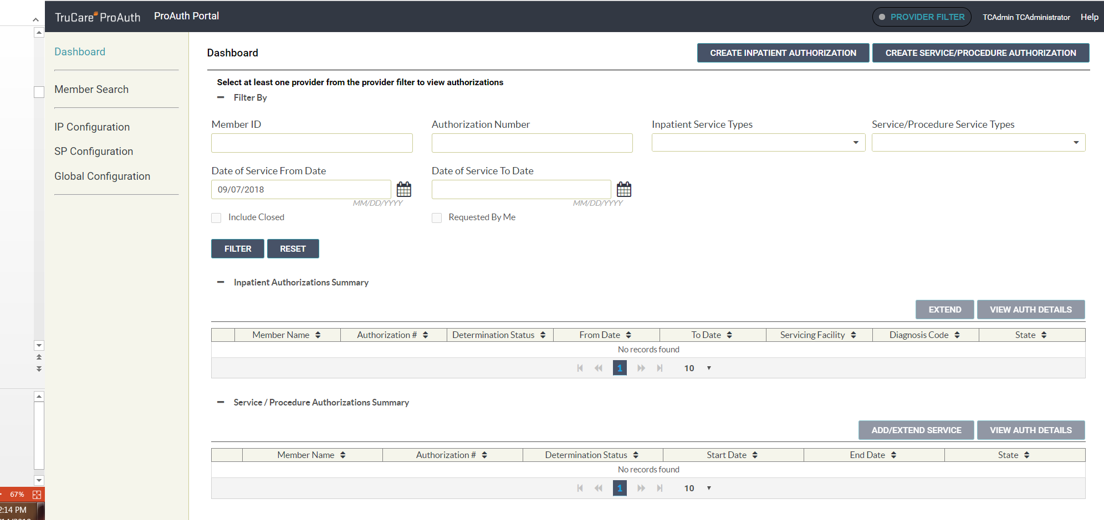
TruCare ProAuth Dashboard
7 Calendar Days from today
Notes:
ProAuth opens to the dashboard where you can locate members and work with authorizations. On the dashboard you can start a member search, begin the workflow for an authorization request, view or filter an authorization summary or a list of providers. You can also continue work on authorizations, such as extending authorizations or adding services. As you move through the application, you can return to the main dashboard page, by selecting Dashboard in the upper left

Slide 4
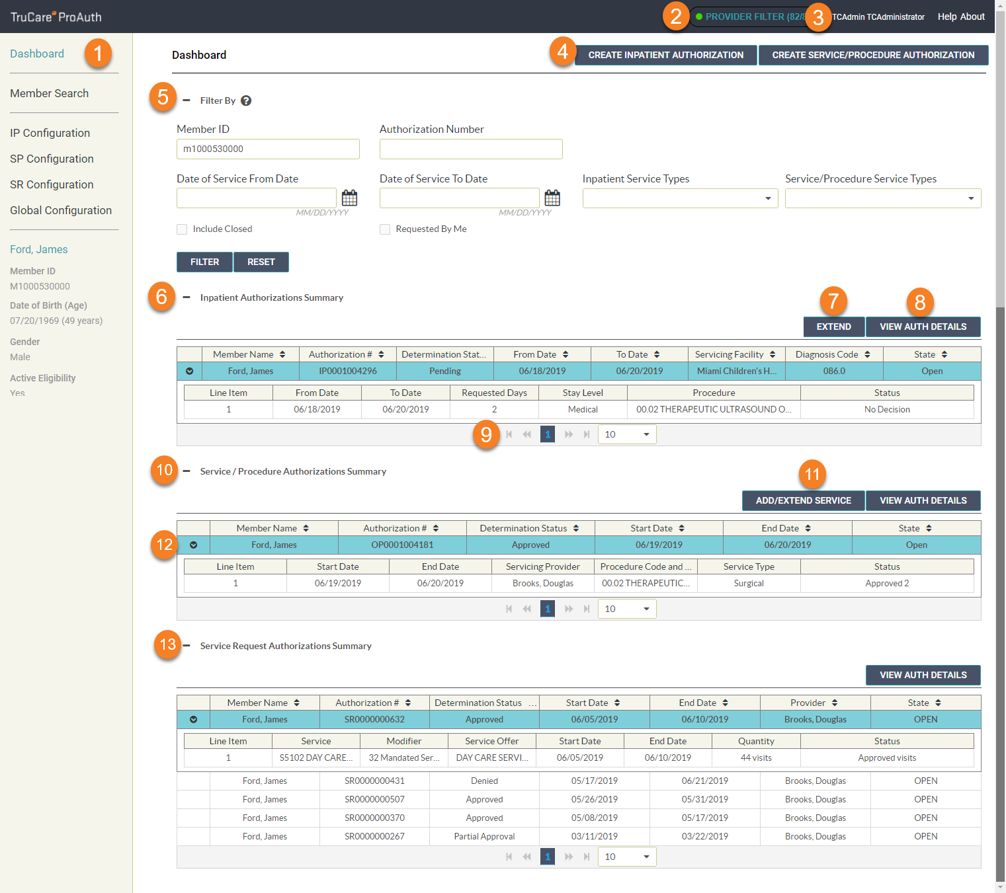
Dashboard Handout
Navigation Pane
Provider Filter
Help and About
Authorization Request Form
Filter By
Inpatient Authorization Summary
Extend IP Authorization
View Auth Details
Page Controls
S/P Authorization Summary
Add/Extend Services
Expand/ Collapse Line Item
Service Request
Notes:
It’s suggested that you print this out to have on your desk while you are getting use to ProAuth.

Slide 5
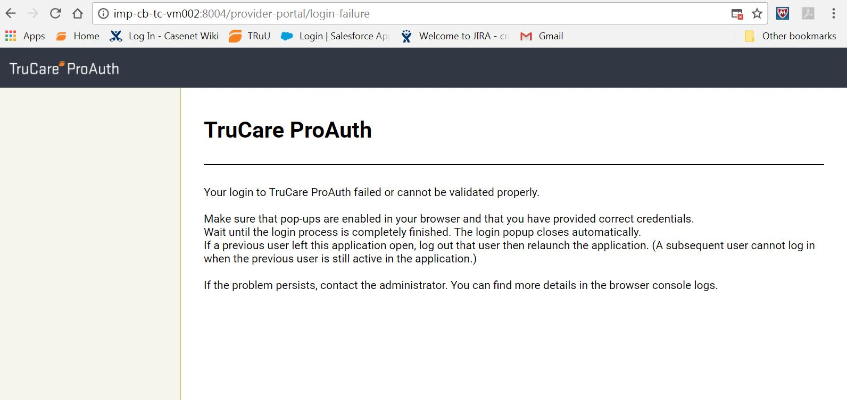
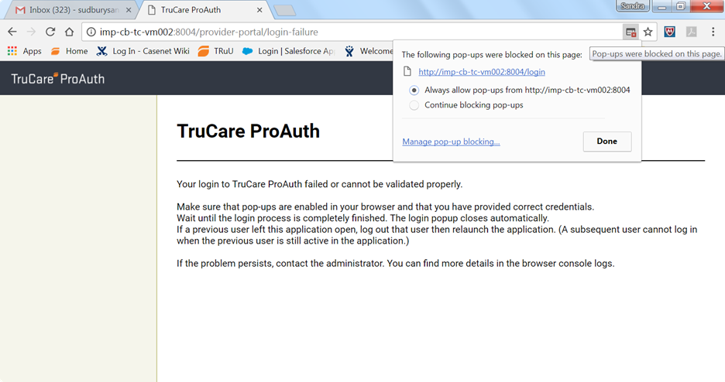
Pop up Blockers
Notes:
Say: Google Chrome is recommended
Screen resolution for your display screen is 1280x1024. Maximum resolution is 1920x1080; minimum resolution, 1280x800.fa

Slide 6
Dashboard Provider Filter - Grey
8
9
10
Notes:
Filter button is gray = no providers are selected from the filter

Slide 7
Provider Filter
Notes:
If you are reviewing Authorizations that you have already submitted, you will need to go to the provider filter and choose the providers you would like to see.

Slide 8
Dashboard - Provider Filter Green
Notes:
The provider filter button list the number of provider/facilities that are associated to your user account
Providers are linked to your user account behind the scenes and they are the only candidate that you are able to view in your completed auth Summary Display

Slide 9
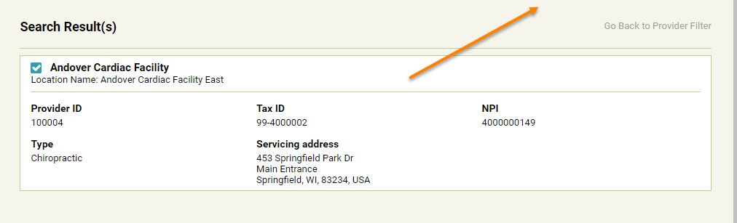
Authorization Summary Screen Results
Notes:
Say: Filtering providers on the working pane
By unchecking provider/facilities in the provider filter you are reducing the number of Authorizations on the working pane.
When you start TruCare ProAuth all the providers linked to your user account are active but not displayed.
If you have 10 providers then the count shows 10/78. If you need only 3 for a session of work
and eliminate all others, the count shows 3/78.
Click Provider Filter to open the slider. Click the button again or anywhere on the screen (outside
the slider) to close the slider.

Slide 10
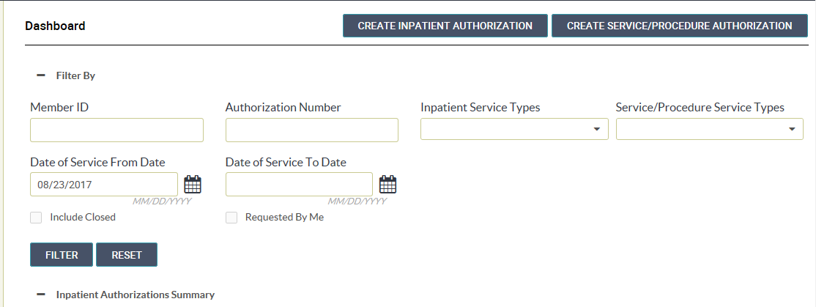
Dashboard - Filtering Authorizations Summary Table
The providers that are associated to me.
Notes:
Say: You‘ll notice that the authorization summary table automatically defaults to the past 7 calendar days. However, the user must do one of 3 things to yield results.
Search via Member ID or Authorization number or for Multiple Authorization results the user must “turn on the Provider Filter”
Because the Provider’s in the Filter are directly linked to a users ProAuth profile.
The section is collapsible.
There is also a “requested by me” option. – Requested by Filtered Providers
When you have completed the search, it is important to reset the filter. As we’ve provided you with a helpful memory retention.

Slide 11
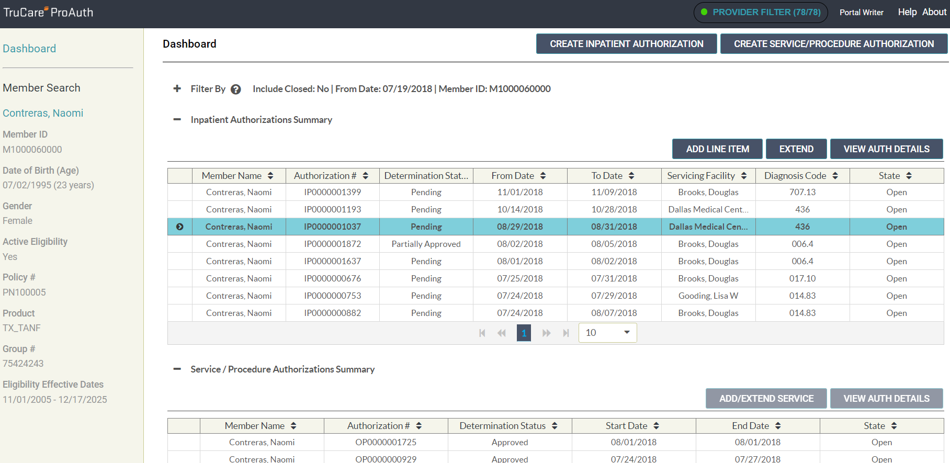
Dashboard - Navigation Pane
Notes:
Say: The left hand side of the navigation pane has an easy “member search” look up button
Once a Member has been obtained via the search, the demographic information remains for easy referencing
The last area in the navigation pane is the name link which will take a user to the member/participant eligibility history screen.

Slide 12
Dashboard - Authorization Summary
Notes:
By clicking on the header item will aluminate in blue
And by clicking on the chevron at the line item will open for additional details
Each distinct service request that is submitted a determination is provided.

Slide 13
View Auth Details
Line items can be opened and expanded from the dashboard
Or from the Bottom of the View Auth Details page.
Notes:
For additional details click on the View Auth Details will open a read only window which you will be able to print.

Slide 14
View Auth Details Scroll
Line items are comprised of service range dates, procedure codes, places of service and provider requesting and servicing (performing the care)
You will also see as you scroll the auth status approved, pend, or deny.
Notes:
Line item details are located at the bottom of the “View Auth Details” Screen.
Don’t forget to scroll left to obtain additional details

Slide 15
View Auth Details Print
Note: Expand line items before you print for the details.
Notes:
Option to print is found at the top of the screen

Slide 16
Printing Authorization Summary
Notes:
Be sure to open the line item before print.

Slide 17
TruCare ProAuth-Member Search
Search by member ID (Full Characters) or 9 Characters AND Date of Birth
Notes:
Members will remain on display in the navigation page until another member is searched/ or selected.
Be sure to search for member before clicking create Auth.

Slide 18
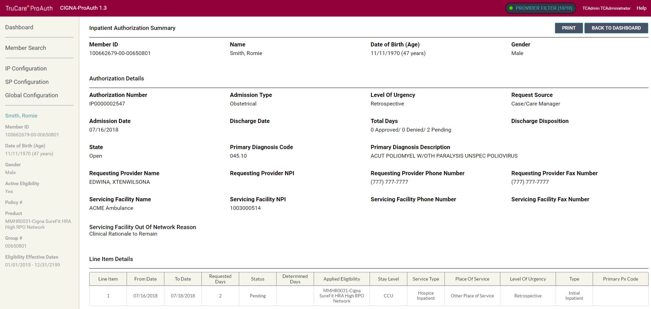
TruCare ProAuth-Authorization Summary
Notes:
Similar to the Auth details page the member summary is another read only screen with the option to print.
Scrolling to the bottom of this page will allow you to see the eligibility history of a member

Slide 19
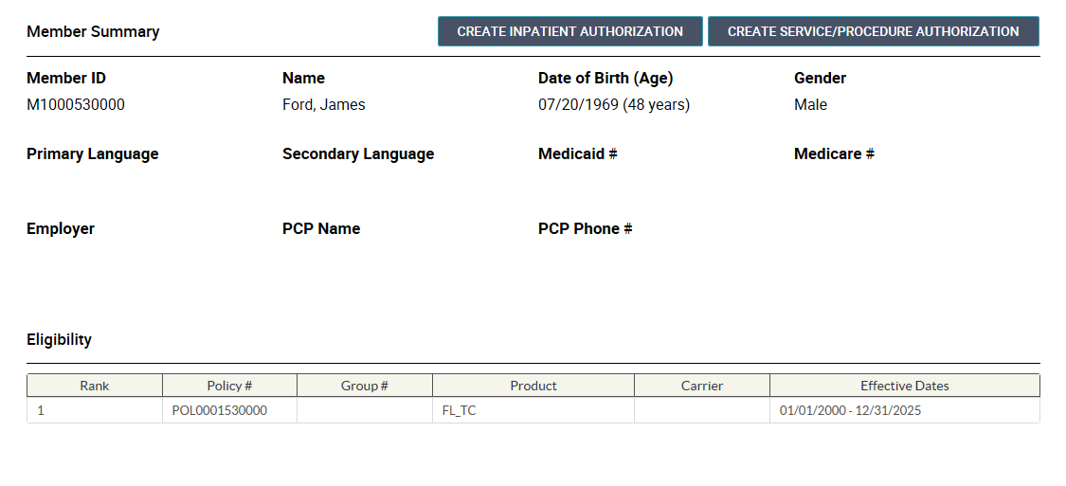
Member Summary
Historical data on Member Eligibility
Notes:
You can also get to this page when a member is in context via the blue hyper link in the navigation pane.

Slide 20
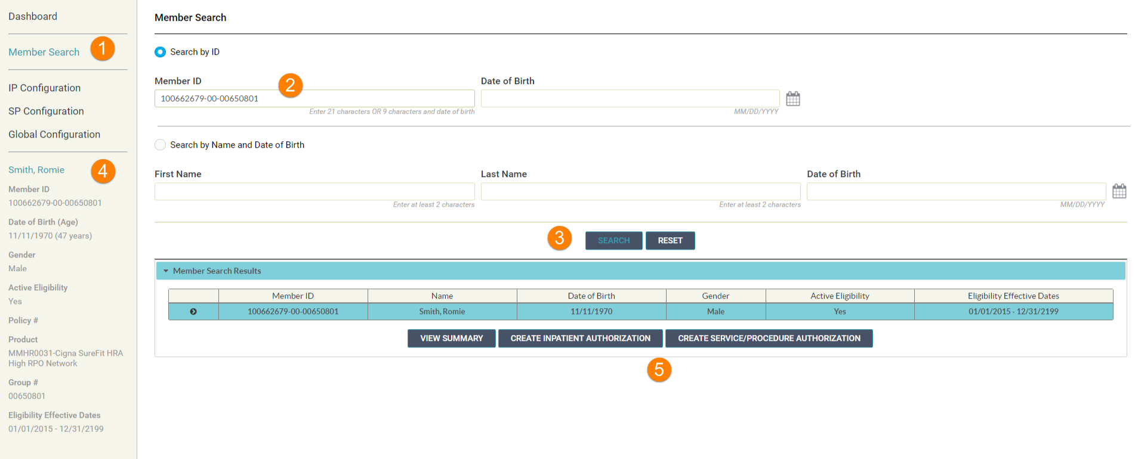
Member Search
Notes:
Best practices
Step 1: Step on would be to conduct the member search first
Step 2: member search configurations is based on customers need
Step 3: Click Search
Step 4: Ensure the member is in context
Step 5: Click IP or SP to begin the request

Slide 21
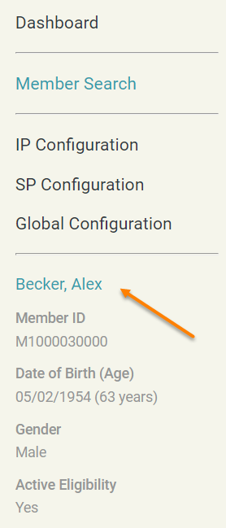
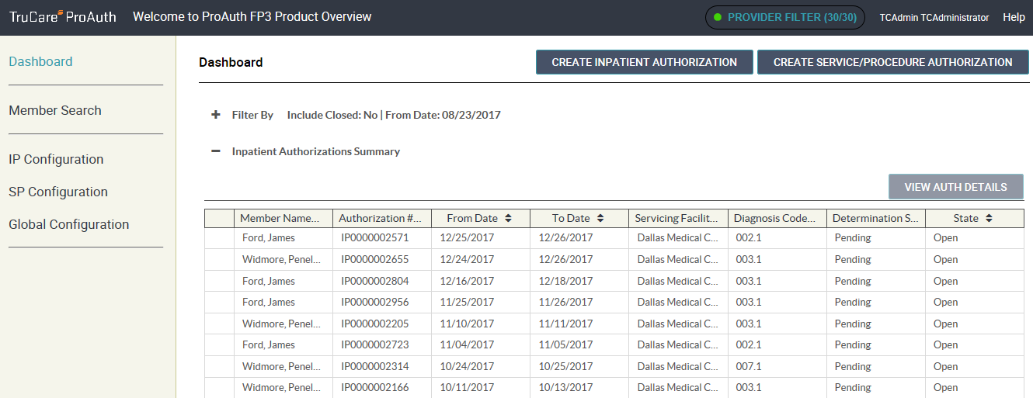
Creating an Authorization
Notes:
Clicking the IP/ or SP from the Dashboard is acceptable if the proper member is in context.

Slide 22
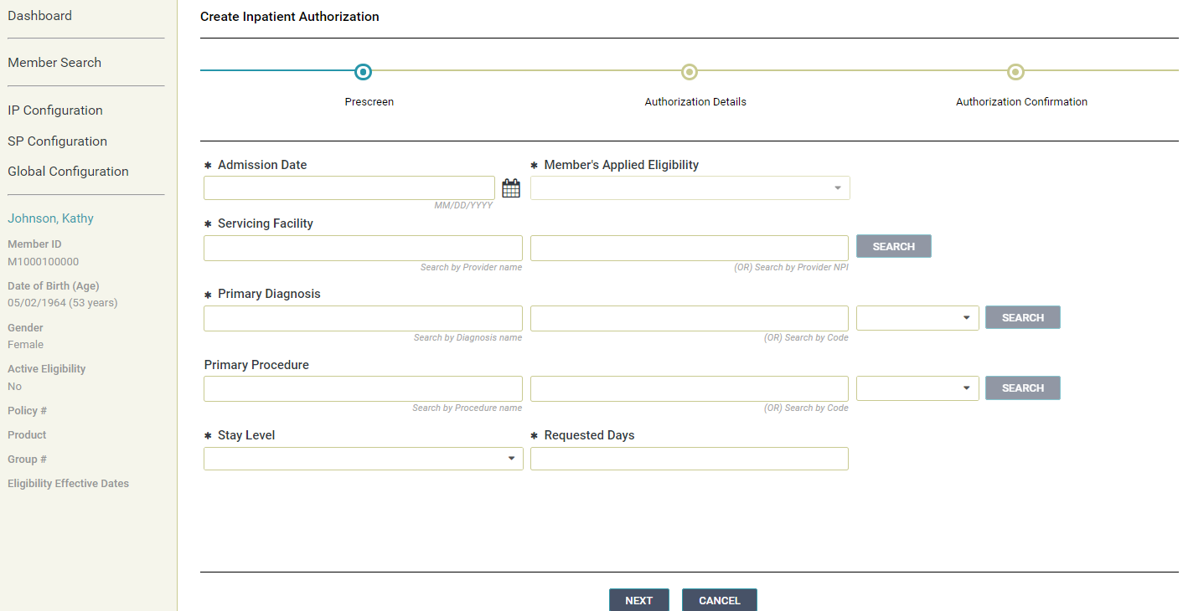
Creating an Inpatient Authorization
Notes:
Once you populate the admission date the eligibility will auto populate.

Slide 23
Member Not Eligible
Notes:
If a member is not eligible you will receive an error message under the eligibility.

Slide 24
Out of Network
Notes:
If you are entering an out of network provider, you will receive this information bubble under servicing facility. This message is information only – it is not an error.

Slide 25
Primary Diagnosis
Notes:
Do not use the ICD-9 code option as you will receive an error.

Slide 26
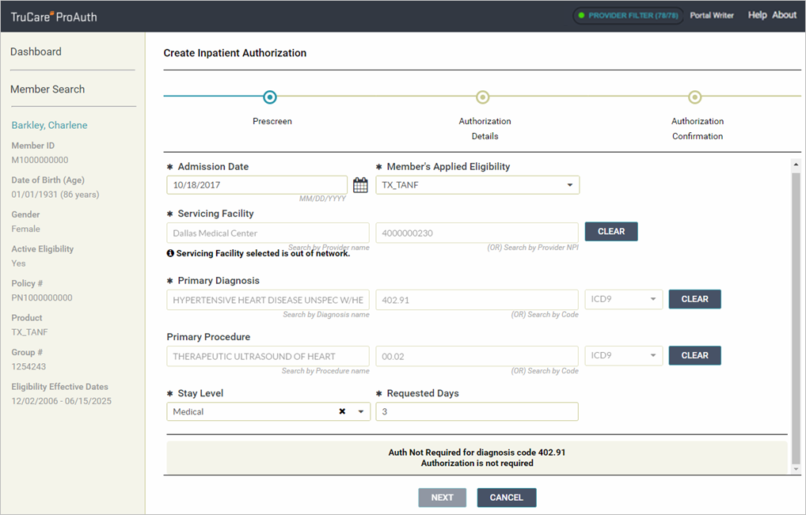
Pre Screen Messaging
Notes:
Authorization Not Required: There is no need to print or screen shot this message as it is captured in the Martin’s Point system as having been requested but not needed.

Slide 27
Authorization Details
Notes:
Secondary diagnosis is not mandatory but can be entered if you have one.

Slide 28
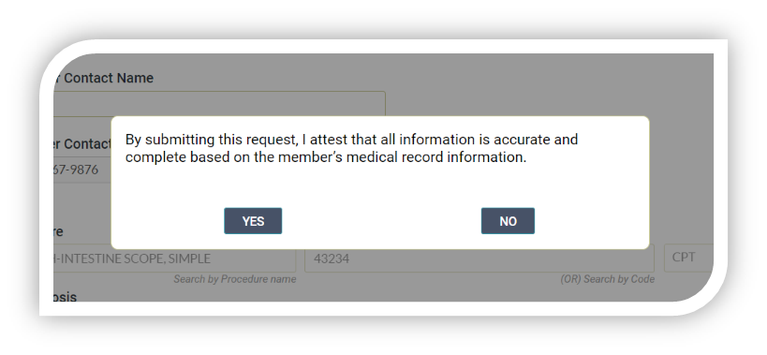
Submit Authorization
Confirmation Page will display when an authorization request is submitted.
Confirmation page includes:
TruCare authorization number
Status of the Auth (approve or pend)
Summary of the Auth
Navigation Instructions for providers for next ‘to-do’
Printable
Notes:
Review the Screen

Slide 29
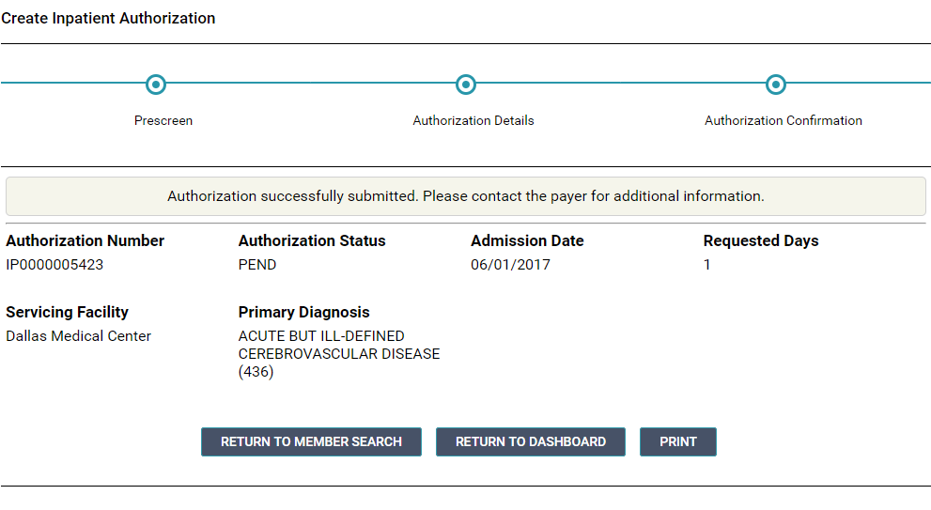
Messages and Slider
Notes:
At this point you will get a message to inform you that the authorization request has been submitted successfully. An authorization summary is presented and includes the authorization number and status.
You can print a copy of the confirmation for your records. (NOTE: The confirmation prints to PDF using the browser print function.)

Slide 30
Creating a Service/Procedure Authorization

Slide 31
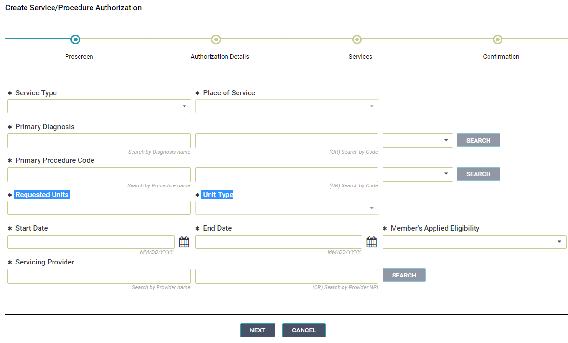
Creating a Service and Procedure Auth
Notes:
Creating a Service and Procedure or Outpatient auth is very similar to creating an IP with the exception of Requesting Units and Unit types

Slide 32
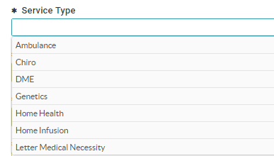
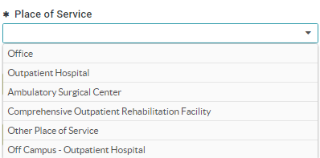
Creating a Service/Procedure Authorization
Notes:
The only difference is that the service types and Units are requested.

Slide 33
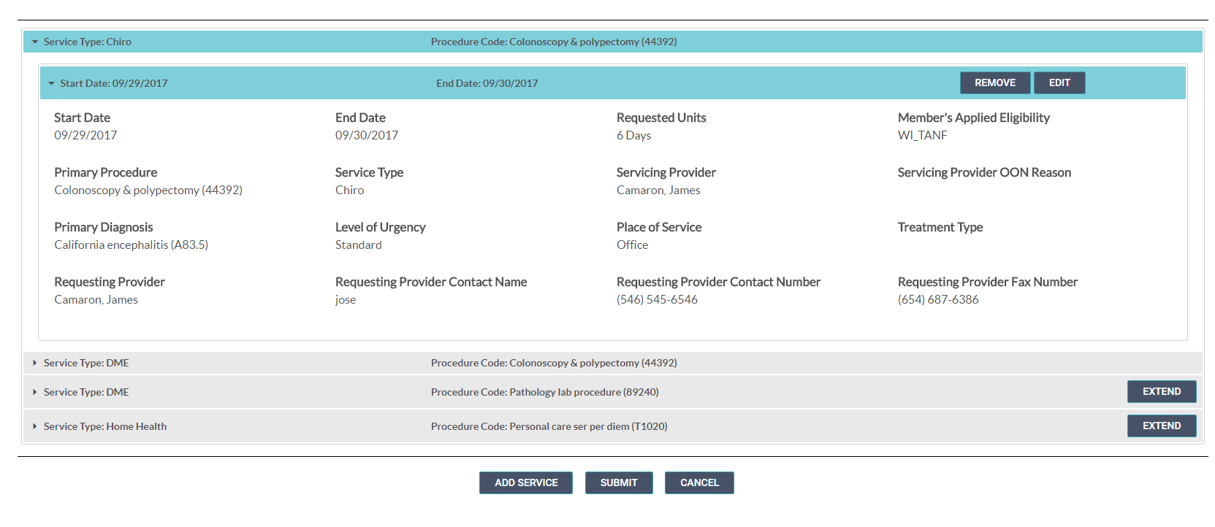
Removing Before Submit
The Initial Service/Procedure can only be edited but not removed. You can however, discard any additional Service/Procedure.
Notes:
Remove one of the two services that you just added only after you have created. The Remove button is then displayed on each service line. Click Remove to discard any added service if it is not needed.

